Slide 1


IEEE CTS
Fall Leadership Meeting
The Leadership
Toolbox
08.25.18
Steve Skarke

Slide 2
Steve Skarke
BSChE, Texas A&M University & MSIE, University of Houston
30+ years in chemical manufacturing industry
Vice President – Kaneka Americas Holding Co.
President - The Kaneka Foundation (501c3)
Recovering Engineer
Leadership Challenge Certified Master Facilitator
Owner – Leading Elements

Slide 3
According to Jim Clifton, Chairman / CEO, Gallup:
Of the 100 Million adults employed full time in the USA….
30% “Engaged & Inspired”
50% “Not Engaged”
20% “Actively Disengaged”
(State of the American Workplace report – 2013)

Slide 4

Why Are You Here?
For the next several minutes, stand up, move around the room, and pick a person you may not know well and introduce yourself.
In 30 seconds explain……
  Why are you part of this organization?
  What unique skills do you bring?
  What do you want to accomplish or change? Why?
Listen to your partner.
Move to another partner….
After the third introduction, sit down.

Slide 5
Question….
What is the difference between
Management and Leadership?
Things
Systems, Processes, Assets
People
Relationships, Motivation,

Slide 6

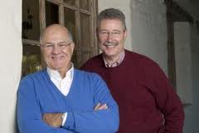
>30+ years of research
>25+ years in circulation
>2++ Million copies sold
“Evidence Based”
Model
Notes:
6

Slide 7
Leadership Fundamentals
Leadership is…
  Everyone’s business
  A relationship
  Self-development
  Learned
  An ongoing process… with practice
  A choice
  ???????

Slide 8
“Leadership is the art of mobilizing others to want to struggle for shared aspirations.”
—Jim Kouzes and Barry Posner
The Leadership Challenge, Third Ed.

Slide 9
1st Law of Leadership:
If you don’t believe in the messenger,
you won’t believe the message.

Slide 10
2nd Law of Leadership:
Do What You Say You Will Do
The Leadership Challenge Workshop Facilitator‘s Guide®, Third Ed., Rev. Copyright © 2006 by James M. Kouzes and Barry Z. Posner. Reproduced by permission of Pfeiffer, an Imprint of Wiley. www.pfeiffer.com

Slide 11
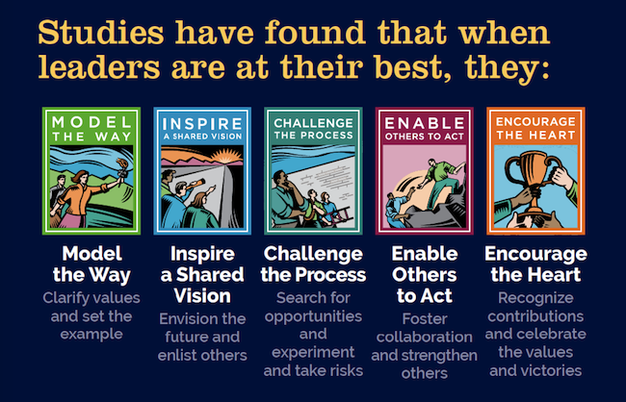

Slide 12


What is The Leadership Challenge?
10 Commitments
Strong Reliability and Validity
30 Behaviors

Slide 13

Clarify values by finding your voice and affirming shared values.
Set the example by aligning actions with shared values.

Slide 14

Envision the future by imagining exciting and ennobling possibilities.
Enlist others in a common vision by appealing to shared aspirations.

Slide 15

Search for opportunities by seizing the initiative and looking outward for innovative ways to improve.
Experiment and take risks by constantly generating small wins and learning from experience.

Slide 16

Foster collaboration by building trust and facilitating relationships.
Strengthen others by increasing self-determination and developing competence.

Slide 17

Recognize contributions by showing appreciation for individual excellence.
Celebrate the values and victories by creating a spirit of community.

Slide 18

Can we measure our leadership effectiveness?

Slide 19
Leadership Practices Inventory (LPI360)
The most widely used 360-degree leadership assessment tool available today.
30 statements measure frequency of leadership behaviors on a 10-point scale.
Leaders gain perspective into how they see themselves as leaders, how others view them, and what actions they can take to improve their effectiveness.

Slide 20
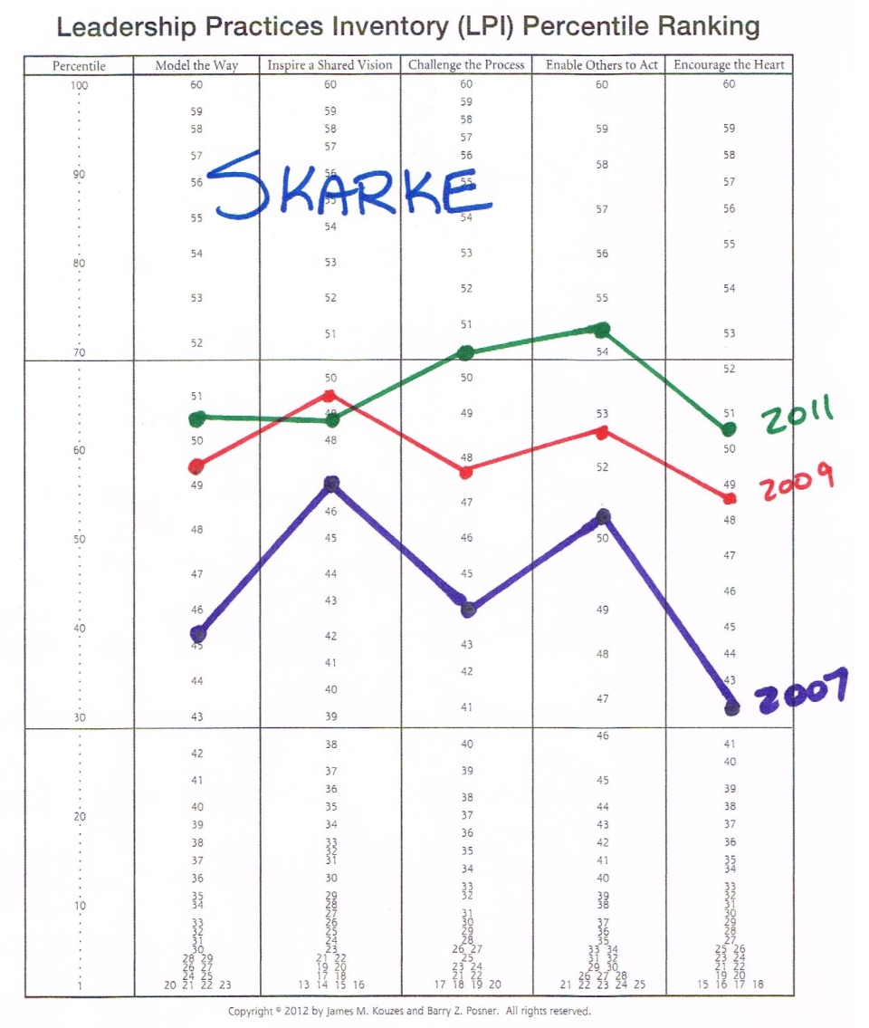
Steve’s LPI360 Comparative Results

Slide 22

Think of a leader who you admire and would willingly follow.
What characteristics would best define them?

Slide 23



Characteristics of Admired Leaders
16% Ambitious
35% Broad-minded
22% Caring
68% Competent
25% Cooperative
25% Courageous
34% Dependable
25% Determined
39% Fair-minded
71% Forward-looking
89% Honest
17% Imaginative
4% Independent
69% Inspiring
48% Intelligent
18% Loyal
15% Mature
10% Self-controlled
36% Straightforward
35% Supportive

Slide 24
CTS Leadership Characterisitics
Ambitious
Broad-minded
Caring
Competent
Cooperative
Courageous
Dependable
Determined
Fair-minded
Forward-looking
Honest
Imaginative
Independent
Inspiring
Intelligent
Loyal
Mature
Self-controlled
Straightforward
Supportive
In small groups, prepare a list of four leadership characteristics that should be modeled by CTS leadership.

Slide 25


An elevator speech, is a short description of an idea, product, company, or oneself that explains the concept in a way such that any listener can understand it in a short period of time. [Wikipedia]
What are the objectives for your committee?
Growth?
Participation?
A New Direction?

Slide 26

Continuous
Improvement
In your groups, brainstorm ideas on how to improve (grow) your chapter.
Collaboration
Community Outreach
Professional Development (Leadership??)
Participation
?????
Be prepared to share a few ideas with the room…..

Slide 27







What’s In Your Library?

Slide 28

Get Started!
COPYRIGHT © 2010 BY JAMES M. KOUZES AND BARRY Z. POSNER
ALL RIGHTS RESERVED. DISCOVER MORE AT WWW.LEADERSHIPCHALLENGE.COM

Slide 29


